Slide 1
Linked List
Lab No. 3
ENGR. AYESHA KHAN

Slide 2

What is a Linked List?
Linked List is a linear data structure which consists of a group of nodes in a sequence. Each node contains two parts.
Data− Each node of a linked list can store a data.
Address − Each node of a linked list contains an address to the next node, called "Next".
The first node of a Linked List is referenced by a pointer called Head

Slide 3
Singly Linked List
Singly Linked List: Singly linked lists contain nodes which have a data part and an address part, i.e., Next, which points to the next node in the sequence of nodes. The next pointer of the last node will point to null.

Slide 4
Creating a Linked List
The node of a singly linked list contains a data part and a link part. The link will contain the address of next node and is initialized to null. So, we will create class definition of node for singly linked list as follows -

Slide 5
NODE CLASS
public class Node
{
public int data;
public Node next;
public Node(int d)
{
data = d;
next = null;
} // Constructor
}

Slide 6
Linked List Class
Now, our node has been created, so, we will create a linked list class now. When a new Linked List is instantiated, it just has the head, which is Null.The SinglyLinkedList class will contain nodes of type Node class. Hence, SinglyLinkedList class definition will look like below.

Slide 7
Linked list class
public class LinkedList
{
public Node head;
// head of list
}

Slide 8
/* Start with the empty list. */
LinkedList llist = new LinkedList();
llist.head = new Node(1);
Node second = new Node(2);
Node third = new Node(3);
llist.head.next = second; // Link first node with the second node
second.next = third; // Link second node with the third node

Slide 9
/* Three nodes have been allocated dynamically.
We have references to these three blocks as head,
second and third
llist.head second third
| | |
| | |
+----+------+ +----+------+ +----+------+
| 1 | null | | 2 | null | | 3 | null |
+----+------+ +----+------+ +----+------+ */

Slide 10
/* Now next of first Node refers to second. So they
both are linked.
llist.head second third
| | |
| | |
+----+------+ +----+------+ +----+------+
| 1 | o-------->| 2 | null | | 3 | null |
+----+------+ +----+------+ +----+------+ */

Slide 11
// Link second node with the third node
/* Now next of the second Node refers to third. So all three
nodes are linked.
llist.head second third
| | |
| | |
+----+------+ +----+------+ +----+------+
| 1 | o-------->| 2 | o-------->| 3 | null |
+----+------+ +----+------+ +----+------+ */

Slide 12
traversing
public void printList()
{
Node n = head;
while (n != null)
{
Console.Write(n.data + " ");
n = n.next;
}
}
Call in main:
Llist.printList();

Slide 13
Various operations on Linked list-insertion
, methods to insert a new node in linked list are discussed. A node can be added in three ways 1) At the front of the linked list 2) After a given node. 3) At the end of the linked list.

Slide 14
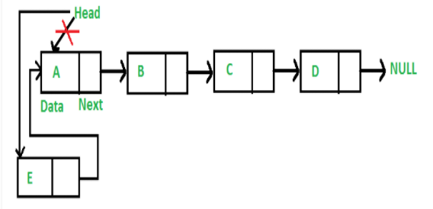
INSERTION-At the front of the linked list
Add a node at the front: (4 steps process) The new node is always added before the head of the given Linked List. And newly added node becomes the new head of the Linked List. For example, if the given Linked List is 10->15->20->25 and we add an item 5 at the front, then the Linked List becomes 5->10->15->20->25. Let us call the function that adds at the front of the list is push(). The push() must receive a pointer to the head pointer, because push must change the head pointer to point to the new node

Slide 15
INSERTION-At the front of the linked list
public void push(int new_data)
{
/* 1 & 2: Allocate the Node &
Put in the data*/
Node new_node = new Node(new_data);
/* 3. Make next of new Node as head */
new_node.next = head;
/* 4. Move the head to point to new Node */
head = new_node;
}

Slide 16
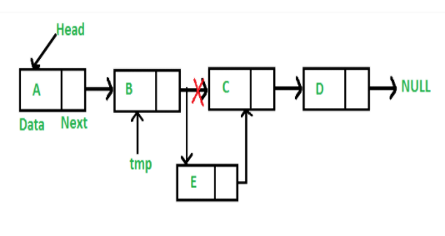
INSERTION-Add a node after a given node
We are given a pointer to a node, and the new node is inserted after the given node.

Slide 17
INSERTION-Add a node after a given node
public void insertAfter(Node prev_node, int new_data)
{
/* 1. Check if the given Node is null */
if (prev_node == null)
{
Console.WriteLine("The given previous" +
" node cannot be null");
return;
}
/* 2 & 3: Allocate the Node &
Put in the data*/
Node new_node = new Node(new_data);
/* 4. Make next of new Node as
next of prev_node */
new_node.next = prev_node.next;
/* 5. make next of prev_node as new_node */
prev_node.next = new_node;
}

Slide 18
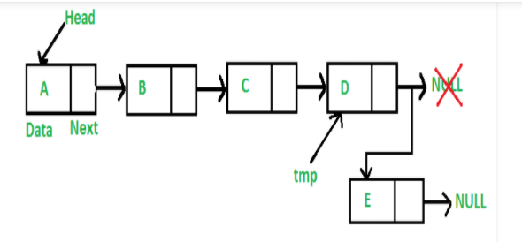
INSERTION-Add a node at the end:
The new node is always added after the last node of the given Linked List. For example if the given Linked List is 5->10->15->20->25 and we add an item 30 at the end, then the Linked List becomes 5->10->15->20->25->30. Since a Linked List is typically represented by the head of it, we have to traverse the list till the end and then change the next to last node to a new node.

Slide 19
INSERTION-Add a node at the end:
public void append(int new_data)
{
/* 1. Allocate the Node &
2. Put in the data
3. Set next as null */
Node new_node = new Node(new_data);
/* 4. If the Linked List is empty,
then make the new node as head */
if (head == null)
{
head = new Node(new_data);
return;
}
/* 4. This new node is going to be the last node,
so make next of it as null */
new_node.next = null;
/* 5. Else traverse till the last node */
Node last = head;
while (last.next != null)
last = last.next;
/* 6. Change the next of last node */
last.next = new_node;
return;
}

Slide 20
FINAL CALLING INSERTION METHODS IN MAIN()
/* Start with the empty list */
GFG llist = new GFG();
// Insert 6. So linked list becomes 6->NUllist
llist.append(6);
// Insert 7 at the beginning.
// So linked list becomes 7->6->NUllist
llist.push(7);
// Insert 1 at the beginning.
// So linked list becomes 1->7->6->NUllist
llist.push(1);
// Insert 4 at the end. So linked list becomes
// 1->7->6->4->NUllist
llist.append(4);
// Insert 8, after 7. So linked list becomes
// 1->7->8->6->4->NUllist
llist.insertAfter(llist.head.next, 8);
Console.Write("Created Linked list is: ");
llist.printList();

Slide 21
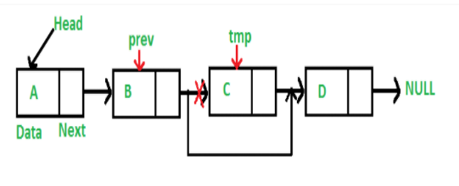
DELETION
Iterative Method: To delete a node from the linked list, we need to do the following steps. 1) Find the previous node of the node to be deleted. 2) Change the next of the previous node. 3) Free memory for the node to be deleted.

Slide 22
DELETION
// Search for the key to be
// deleted, keep track of the
// previous node as we need
// to change temp.next
while (temp != null &&
temp.data != key)
{
prev = temp;
temp = temp.next;
}
// If key was not present
// in linked list
if (temp == null)
return;
// Unlink the node from linked list
prev.next = temp.next;
}
void deleteNode(int key)
{
// Store head node
Node temp = head, prev = null;
// If head node itself holds
// the key to be deleted
if (temp != null &&
temp.data == key)
{
// Changed head
head = temp.next;
return;
}

Slide 23
CALLING DELETION METHOD:
llist.deleteNode(1);

Slide 24
Lab Tasks
Write a program to create a linked list and pertform
*traversing
* Insertion
*deletion

